Slide 1

Gitting Started
DSBA 6190-U90 | Colby T. Ford, Ph.D.

Slide 2

What is Git?
Version Control
Which changes were made?
Who made the changes?
When were the changes made?
Why were changes needed?
Terminology
Code is stored in a repository
If you want to use someone else’s code and make changes, you can fork it. Then, submit a pull request to try and merge the changes back in
Your team can work on separate branches of the same repository
Repositories are usually initialized with a README.md, a .gitignore, and a license.
https://www.youtube.com/watch?v=w3jLJU7DT5E

Slide 3
Commands
https://guides.github.com/introduction/git-handbook/
https://lab.github.com/githubtraining/introduction-to-github
git init
git clone
git commit
git status
git branch
git merge
git pull
git push
Initializes a brand new Git repository and begins tracking an existing directory
Creates a local copy of a project that already exists remotely
Saves the snapshot to the project history and completes the change-tracking process
Shows the status of changes as untracked, modified, or staged
Shows the branches being worked on locally.
Merges lines of development together
Updates the local line of development with updates from its remote counterpart
Updates the remote repository with any commits made locally to a branch.

Slide 4


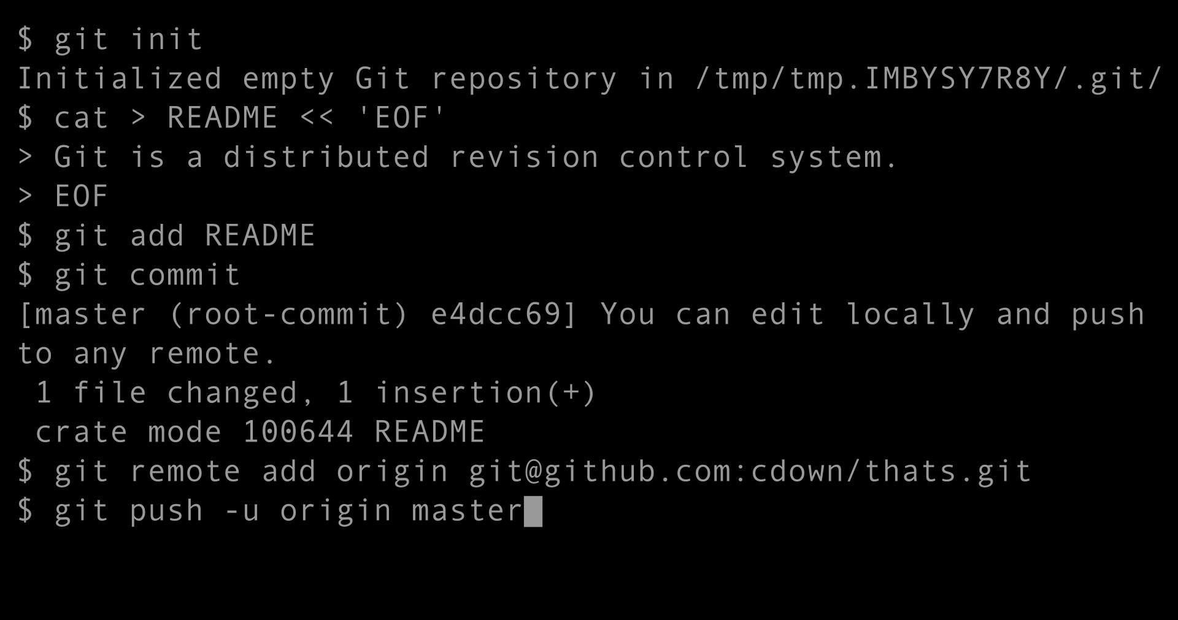





Various Tools to Git it Done
Git Clients
Repository Services

Slide 5
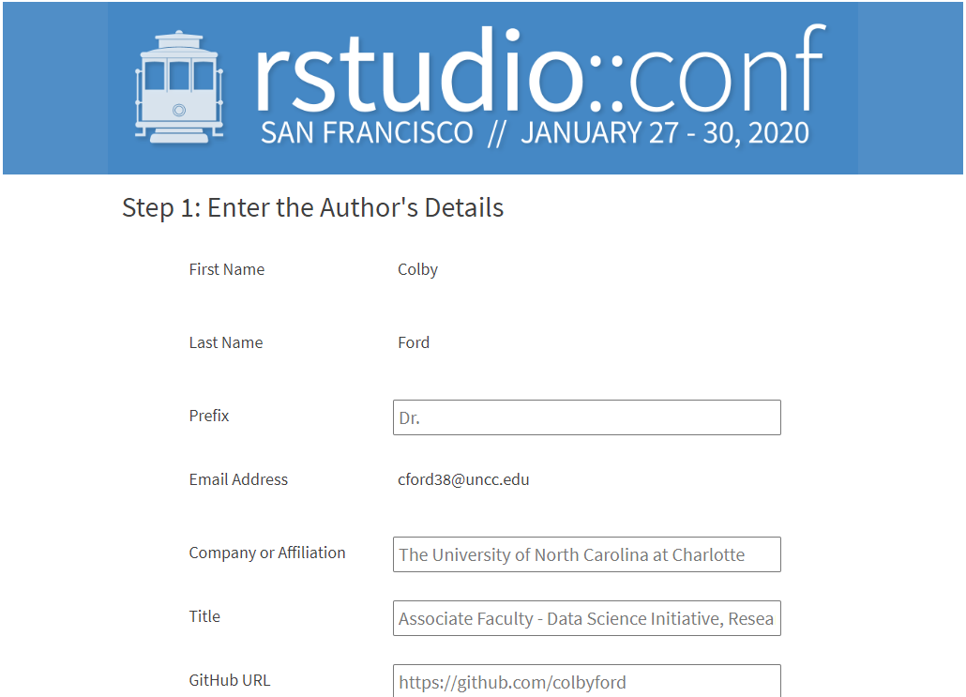

Slide 6
Groups!
α
β
γ
δ
ε
ζ
Xia, Chunqiu
Xiao, Diwen
Jiang, Jiang
Kamtam, Nivedita
Vavilala, Srivan
Lai, Xinxin
Gulley, Alexander J.
Kuppusamy, Balavigneswaran
Sheng, Haomin
Lei, Jiamin
Huang, Lei
Zheng, Wen
Kanumuri, Akshata L.
Vellore Prabhakar, Krithika
Singaravel, Muralidharan
Ramakrishnan, Sthanu Subramanian
Sharma, Tarun
Osei-Fosu, Augustine K.
Cope, Blake W.
Helfrich, Eric
Ranjbar, Layla P.
Joy, Noble
Thomas, Philip
Garg, Divya
Chavan, Kshitija
Kurundachalam, Muraleetharan
Nottath, Ramkumar
Agrawal, Shruti
Bapat, Anjali
Cardenas, Arturo
Demir, Elif
Hoertt, Jacob P.
Mucha, Julian R.
Penmatha, Manideep Varma
Almasri, Osama

Slide 7
